Slide 1




LLMs for I/Os
A Functionalities and Applications Masterclass

Slide 2




Introductions
Karim Badr
Matthew Bennett
Bao Ho
Nino Sziedell
Senior Research Scientist
Research Scientist
PhD Student
Global Analytics Consultant

Slide 3







Agenda
ChatGPT & LLMs – An Overview
Basic Prompt Engineering
Internet Research with ChatGPT
Working with Files & Custom GPTs
Using APIs

Slide 4
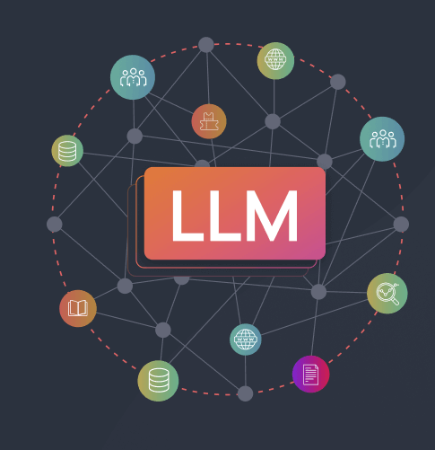
ChatGPT & LLMs
An Overview
4 April 2025

Slide 5

Could ChatGPT Have Written This?
Have you had to write anything this past year and wondered if ChatGPT could do it faster?
Notes:
“Raise your hand if you've written something in the last year—an email, a report, a job description—and quietly thought, ‘I wonder if ChatGPT could do this faster’”
“Now, raise your hand if you suspect that I might have thought of the same thing, and ChatGPT helped me to write this hook.”
“You are correct--partly. I asked ChatGPT to write a hook [show slide example], and it generated that question. I liked it—but thought, ‘Hey—I could add a bit to this and get a bit meta!’.
This showcases one of the best use cases for ChatGPT: using it as a starting point for any kind of written content you have to produce and then putting your own spin on it.
Presentation goal: Show you how to maximize the value you derive from using ChatGPT and similar LLM services.

Slide 6
Overview Agenda
1
Understand ChatGPT & LLMs
2
Review recent developments in the commercial LLM service space
3
Look ahead to what’s coming next

Slide 7
What is ChatGPT?
Commercial, publicly available artificial intelligence (AI) service
Launched November 2022 by OpenAI
Reached 100M+ users in 2.5 months
Generates any written content based on simple inputs
Source of knowledge
General chatting
Help with work – writing reports, lesson plans, etc.
Coding
Notes:
ChatGPT launched in November 2022 by OpenAI and reached over 100 million users in 2.5 months – a historical record at the time. (Netflix took ~3.5 years to reach 1 million users). It has become so popular due to the wide range of use cases.

Slide 8
How Does ChatGPT Work?
Generative AI – Generates content (output) based on a user prompt (input)
Large Language Model (LLM) – Generative AI model that uses text as input & produces text as output
*GPT = Generative Pretrained Transformer
Input
Model
Output
Prompt
GPT-4o
Response

Slide 9
Natural Language Processing (NLP)
Text Generation and Comprehension: Crafting coherent and contextually relevant text based on input prompts.
Question Answering and Reasoning: Providing informative responses and engaging in complex problem-solving.
Language Translation: Converting text between languages while maintaining nuance and context.
Summarization: Condensing lengthy documents into concise summaries without losing essential information.
Natural Language Understanding
Understanding written language
Natural Language Generation
Producing new written content
Notes:
Large Language Models, like ChatGPT, are part of the broader field of Natural Language Processing, or NLP. NLP itself has two key branches:
Natural Language Understanding (NLU): Interpreting and making sense of human language (e.g., identifying intent, extracting meaning, answering questions).
Natural Language Generation (NLG): Producing coherent, human-like language in response (e.g., writing summaries, generating emails, composing stories).
LLMs do both parts of NLP
Both processes work by using a variety of data pre-processing and processing methods to turn written text (words, punctuation) into tokens, and tokens into vectors of numbers in realspace.
For a technical understanding, you can view 3Blue1Brown’s excellent video series on the topic, linked in the GitHub repo.
This allows LLMs, like the GPT models that ChatGPT uses, the ability to do a wide variety of tasks, such as [CLICK & READ]

Slide 10





It’s Not Just ChatGPT
Model | Company
ChatGPT | OpenAI
Claude | Anthropic
Gemini (formerly Bard) | Google
LLAMA | Meta
DeepSeek | DeepSeek
Notes:
This presentation will focus on ChatGPT, but we also want to mention other major offerings in this space. This is an area with billions upon billions of dollars of research and development, and the space changes and evolves rapidly.
The goal is not to push the adoption of ChatGPT as a product. However, it is a clear leader in this space, as far as being the first and most widely-recognized commercial LLM product, and often pioneers new functionality in the commercial LLM space. We believe that everything we discuss here will be applicable to all other commercial LLMs.
Claude (Anthropic): Emphasizes safety and alignment, offering advanced reasoning and long-context processing.​
Gemini (Google): Integrates with Google Workspace, providing robust language understanding and generation features.
LLAMA (Meta): Although not used in a commercial app, it is an open-source LLM that is very popular for its capacity to be used in a variety of use cases.
DeepSeek: A Chinese AI startup that has rapidly emerged as a significant player in the LLM landscape.​
DeepSeek-V3: Released in December 2024, this model boasts 671 billion parameters and has demonstrated performance on par with leading models like GPT-4 and Claude 3.5 Sonnet, despite being developed at a fraction of the cost.
DeepSeek-R1: Launched in January 2025, focusing on reasoning tasks and showcasing efficiency using less advanced hardware, challenging the notion that high-end chips are necessary for cutting-edge AI development.

Slide 11
LLM Services are Evolving Quickly!
Factor | Then (2022) | Now (2025)
Context Window Limit (Tokens) | 4,096 | (Up to) 128,000
Input Modality | Text only | Text, images, voice
Features | Limited plugins & tools | Custom GPTs, advanced API features, agents
What’s on the horizon?
AI Agents (more autonomy & control)
E.g., Operator (OpenAI)
Democratization of AI
Lower barriers to entry
Ethical & Regulatory Considerations
Environmental, social impact concerns
Notes:
Advancements in AI Agents:
Autonomous Task Execution: Future LLMs may evolve into agents capable of performing complex tasks with minimal human intervention.​
Democratization of AI:
Lower Barriers to Entry: Continued open-source initiatives may enable more organizations to develop and deploy sophisticated AI models without substantial resources.​
Ethical and Regulatory Considerations:
Responsible AI Development: Emphasis on creating transparent, fair, and accountable AI systems to address societal impacts.​
Only if governments force AI companies to adopt these practices, however.

Slide 12
Discussion Topics
Basic Prompt Engineering
Internet Research with ChatGPT
Working with Files & Custom GPTs
Using APIs

Slide 13

Working
with
Prompts

Slide 14
What is a prompt and what is prompt engineering?
A prompt in context of AI and Large Language Models is a piece of information used to communicate between different entities of a conversation/chat.
Agent (LLM)
User (Person interacting with the LLM)
Developer (Person building the LLM)
Prompts can occur in different ways. Most common is a natural language text prompt but in some cases prompts are images, videos or other file/document types.
Prompt engineering describes the process where the user structures or crafts an instruction (user prompt) for the AI model in order to produce the best possible response.
A user prompt contains any of the following elements:
Instruction
Context
Input Data
Output Indicator

Slide 15
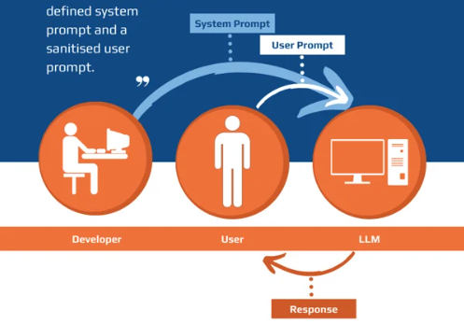

Slide 16





What are prompts used for?
Creative Tasks
Summaries
Brainstorming
Comparisons (e.g. difference between LLMs)
Visualization (e.g. tables, graphs)

Slide 17

Prompt Engineering Techniques

Slide 18
How to build a prompt – Basics
Be clear and specific
Include format requirements
Don‘t tell what not to do
Use action verbs
Assign roles
What makes a good leader?
vs.
I am a recruiter in a large organization. List the 3 most effective predictors of job performance during the recruitment process. Summarize each predictor in one sentence.

Slide 19
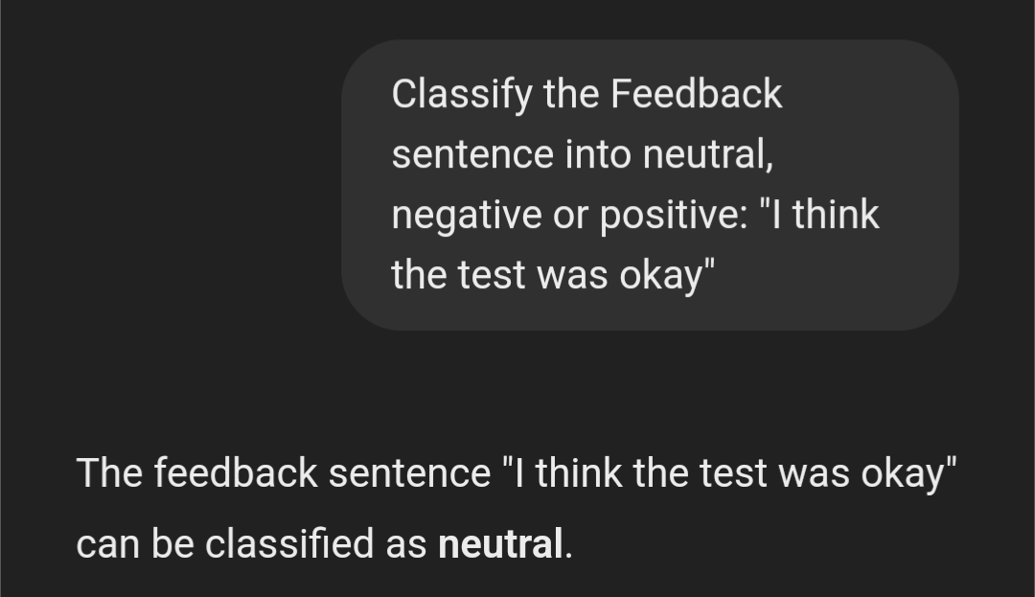
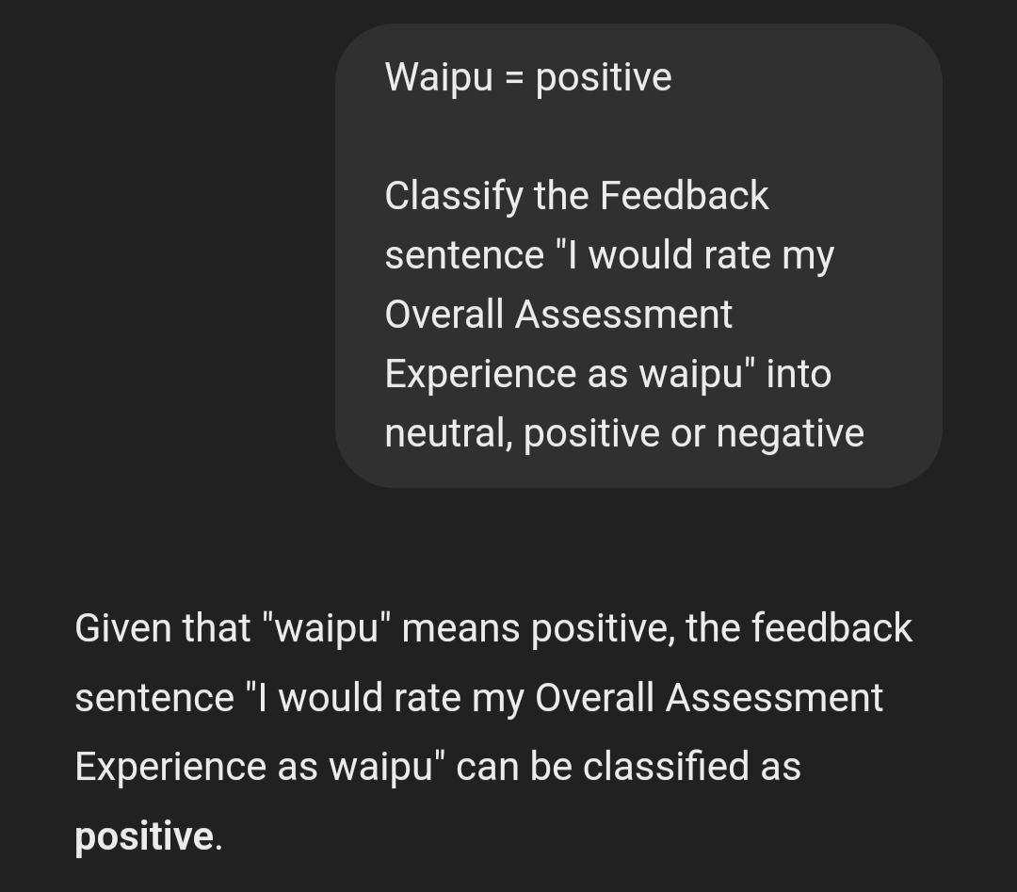
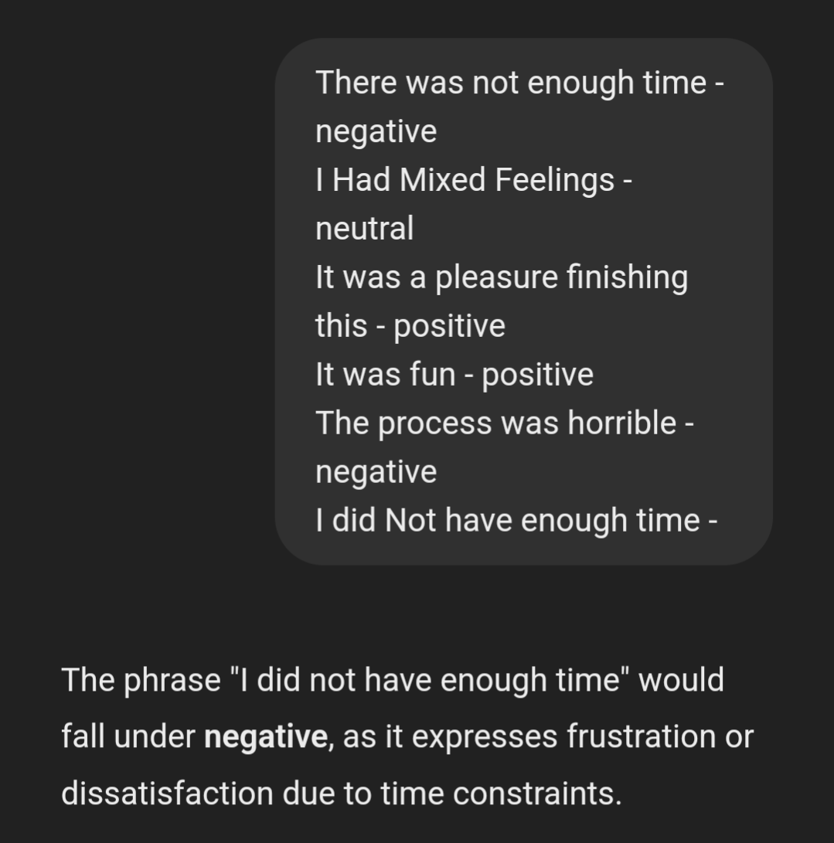
Zero-shot vs. One-shot vs. Few-shot
0 1 ≥2

Slide 20
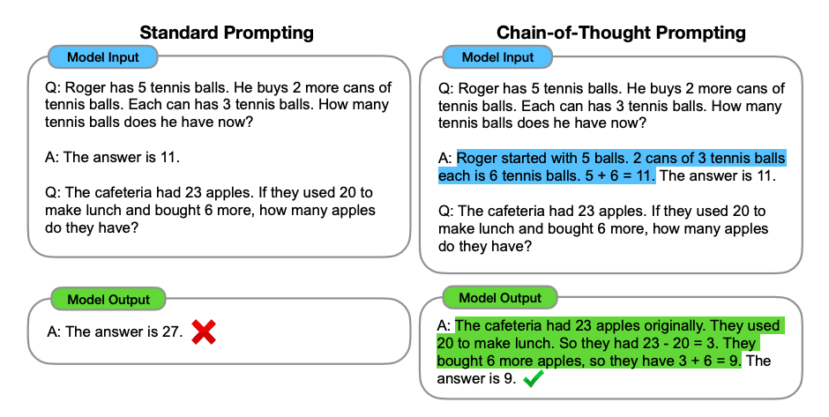
Chain-of-Thought (CoT)

Slide 21
Two LLM types
Non-reasoning (e.g. GPT-4)
Prompted reasoning
Ideal for simpler tasks
Reasoning (o1 and o3-mini)
Built-in reasoning
Longer and more technical answers
Short answers
Ideal for complex tasks
Fast and relatively cheap
Slower and more expensive
→ Zero-/one-/few-shot and chain of thought
→ Different prompting technique

Slide 22
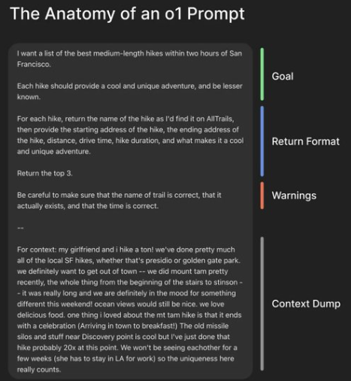
Reasoning models – o1 and o3-mini
Built-in CoT reasoning
Conventional prompting methods not recommended
o1 Prompt
Idea is to guide the AI through a clear sequence of logical segments with a single well-defined prompt
Set clear context
Give specific instructions
Define the output format
Include warnings if needed
Set role or tone if needed

Slide 23

Advanced Prompting

Slide 24
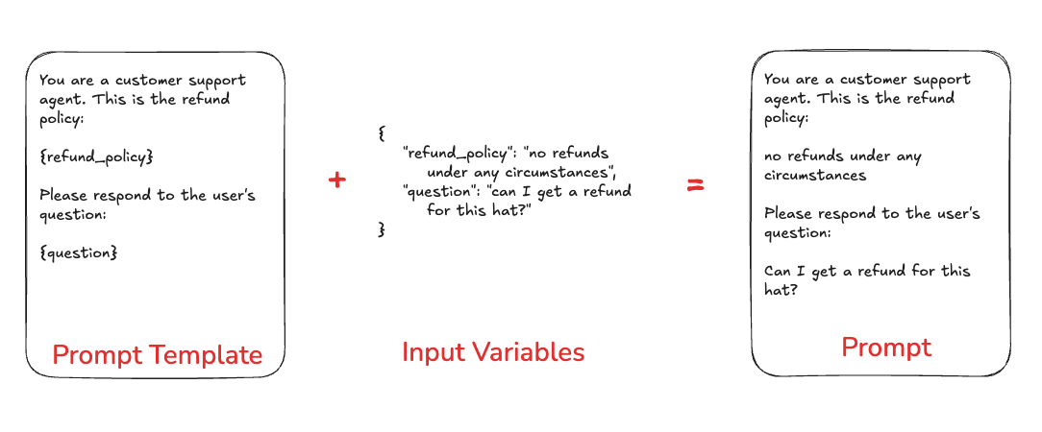
Prompt Templates
Translate user input and parameters into instructions for a language model

Slide 25
How far can we go?
Other types of prompts (e.g. video, voice, links)
Various other prompt engineering techniques
Interacting with API
Working with files

Slide 26

Internet Searches & Research with ChatGPT
Internet Searches
4 April 2025

Slide 27
Internet Searches with ChatGPT
LLMs must be trained on a corpus of content that has a cutoff date
By default, unable to answer questions about recent events
Knowledge is limited to whatever is in the content bank
Even when writing about content in the content bank, hallucinations may cause errors when answering questions
When given the right tools, LLMs can access search engines & read websites to obtain information to use in a response

Slide 28
ChatGPT as a System
Image Source
User Action
Control Layer
Output
LLM (GPT-4o)
Control Layer: Executive layer that guides the flow of processing user prompts & actions
Notes:
To understand how ChatGPT uses the internet, we need to know how ChatGPT processes user actions. ChatGPT uses one of the many GPT models—GPT-4o, GPT-o3, etc.—as the engine to craft responses, but the platform is more than just the LLM. Users can trigger a range of actions, either manually or via the prompt they use, to have the system call a variety of functions.
You should think of ChatGPT as a system of interlocking parts. We will not discuss all the parts, but one concept you should know is the control layer [CLICK]. The control layer is an executive, orchestration layer that handles the processes associated with handling a prompt. Sometimes, passing a prompt to the model will cause it to call one of many functions, such as browsing the internet or running code blocks to interact with files. The control layer helps ensure prompts are not malicious and result in data breaches, and it also helps to ensure that final outputs follow certain restrictions and guidelines (e.g., not creating harmful or violent content).
The actual process flow is more complex, but as a general rule, a user action triggers an action from the control layer, which may do one or more actions while crafting a response, which is ultimately given as an output.

Slide 29
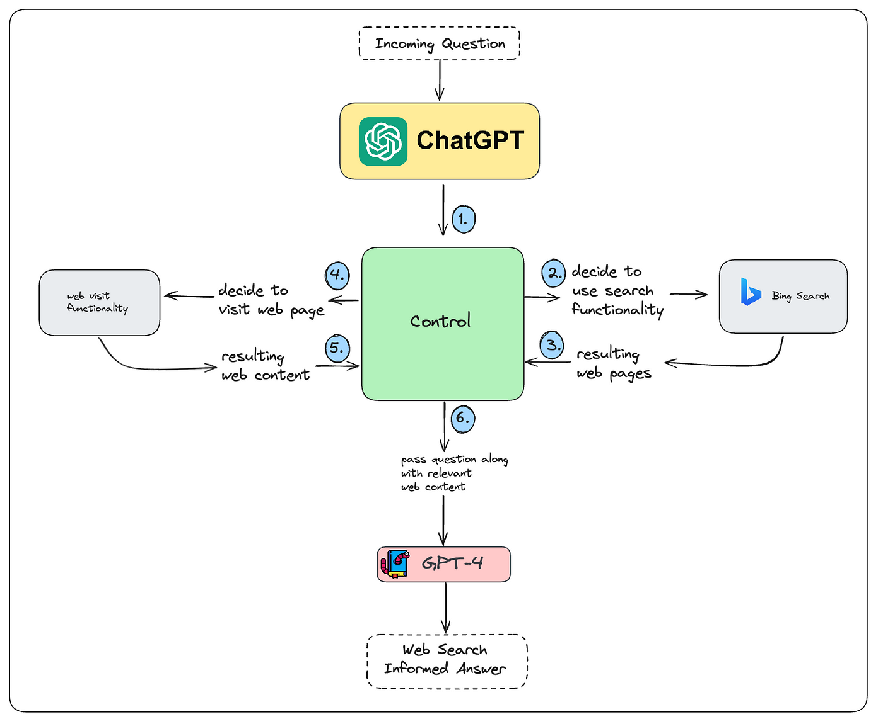

Internet Search: Interaction Modes
User-Guided Browsing
Fully AI-Driven Search
Notes:
There are two interaction modes for internet browsing we should be aware of.
The first is User-Guided Browsing (Human-in-the-loop), which is what the basic Search function does for ChatGPT. In this case, the control layer triggers a function call to the Search() function, which uses the Bing search engine to search for a phrase. A list of possible web pages are returned to the control layer, which then calls other tools to this but the websites and scrape data. The resulting information is returned, which the control layer passes to (in this case) GPT-4 as part of the prompt to let it create the final output. This makes this kind of human-in-the-loop web browsing essentially a smart web search tool, which combines results from multiple web pages to write a response. This kind of interactional searching is very useful when you want to actively explore a topic and have an AI agent do a lot of the actual leg work of searching for information.
A second interaction mode is Fully AI-Driven Search. In this case, the control layer will use multiple, sequential web searches to get the information necessary to respond to a very high-level prompt. It is very likely other tools would also be used, such as writing and executing code, based on the results of the web search. There are some services, such as AutoGPT and BabyAGI, which would use this type of process. As of right now, no widely available ChatGPT service does this. The Deep Research functionality comes close to this, but is not quite. (We will come back to this later.)

Slide 30

Example: Searching for Recent Events
1

Slide 31
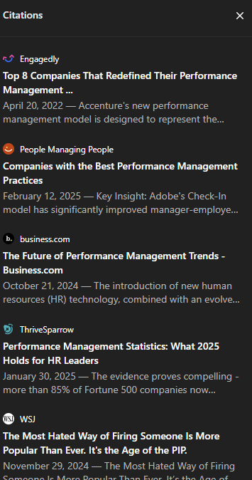
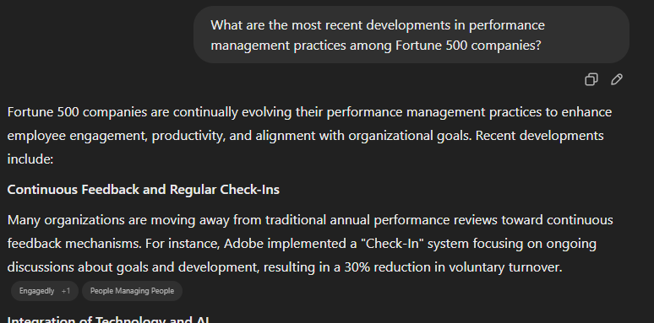

2
3

Slide 32
Considerations for Internet Searches & Research
Best Practices
Treat ChatGPT as a knowledgeable and eager, albeit inexperienced and sometimes careless, assistant
Clear, specific prompts
❌ “Tell me about remote work”
✅ “What does recent research say about the impact of remote work on employee productivity and satisfaction?”
Save conversations & ask for links to be printed
✅ After the search is concluded: “For all sources cited, print out the web page name and URL of each source without markdown formatting.”
Steer towards high-quality & reputable sources
✅ Tell it which sources to focus on
✅ Tell it which sources to avoid
Avoid the black box as much as possible
✅ Document when and how you use ChatGPT web searching for any work or research project

Slide 33
Considerations for Internet Searches & Research
Best Practices
Be critical
“Do I really need to use an LLM here? Does the benefit outweigh the cost of not doing the actual search myself?”
✅ Review all sources for accuracy of claims
✅ Critically evaluate the claims being made
Best use case may be to identify & categorize sources, which you review manually

Slide 34
Considerations for Internet Searches & Research
Warnings & Pitfalls
Hallucinations
⚠️ May confidently cite sources that do not exist, or connect information to the wrong source
✅ Always review your sources
Source credibility & bias
⚠️ Sources may not be credible or may be biased
✅ Keep source count low
✅ Use iterate-and-drill-deeper methods to ensure high-quality sources
Incomplete or truncated information. (The LLM cannot read all webpage contents. Often, snippets of webpage contents are read.)
⚠️ May cause it to miss important details
Ethical & Confidentiality concerns
⚠️ Unless data controls are used, anything you enter may be saved & used to train/refine the model
Over-reliance & skill atrophy

Slide 35
Considerations for Internet Searches & Research
Warnings & Pitfalls
No control over search flow
Changes to control layer or other parts of ChatGPT system may affect quality of web results over time
⚠️ Indexing system of search engine may change
⚠️ChatGPT may not do a thorough search, and SEO practices may cause low-quality results to be prioritized
⚠️ Other changes, such as limitations to how many web pages to read per query

Slide 36

Deep Research
Like Research, but Deeper
Released in early 2025 for all Plus and Teams users
Other services have similar functionality
Key differences
Autonomous, multi-step approach
Multiple, sequential web searches based on a high-level direction
Directed mostly by the control layer
Designed to generate detailed reports with accurate citations
Long process – can take 5 – 30 minutes
Best practices
Craft long, detailed prompts
Include background information with file uploads

Slide 37

Working with Files & Custom GPTs
4 April 2025

Slide 38
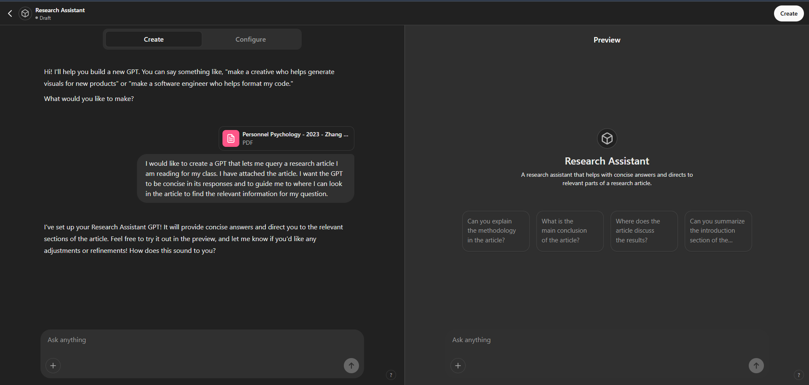
Working with Files & Custom GPTs
Notes:
“I would like to create a GPT that lets me query a research article I am reading for my class. I have attached the article. I want the GPT to be concise in its responses and to guide me to where I can look in the article to find the relevant information for my question.”

Slide 39
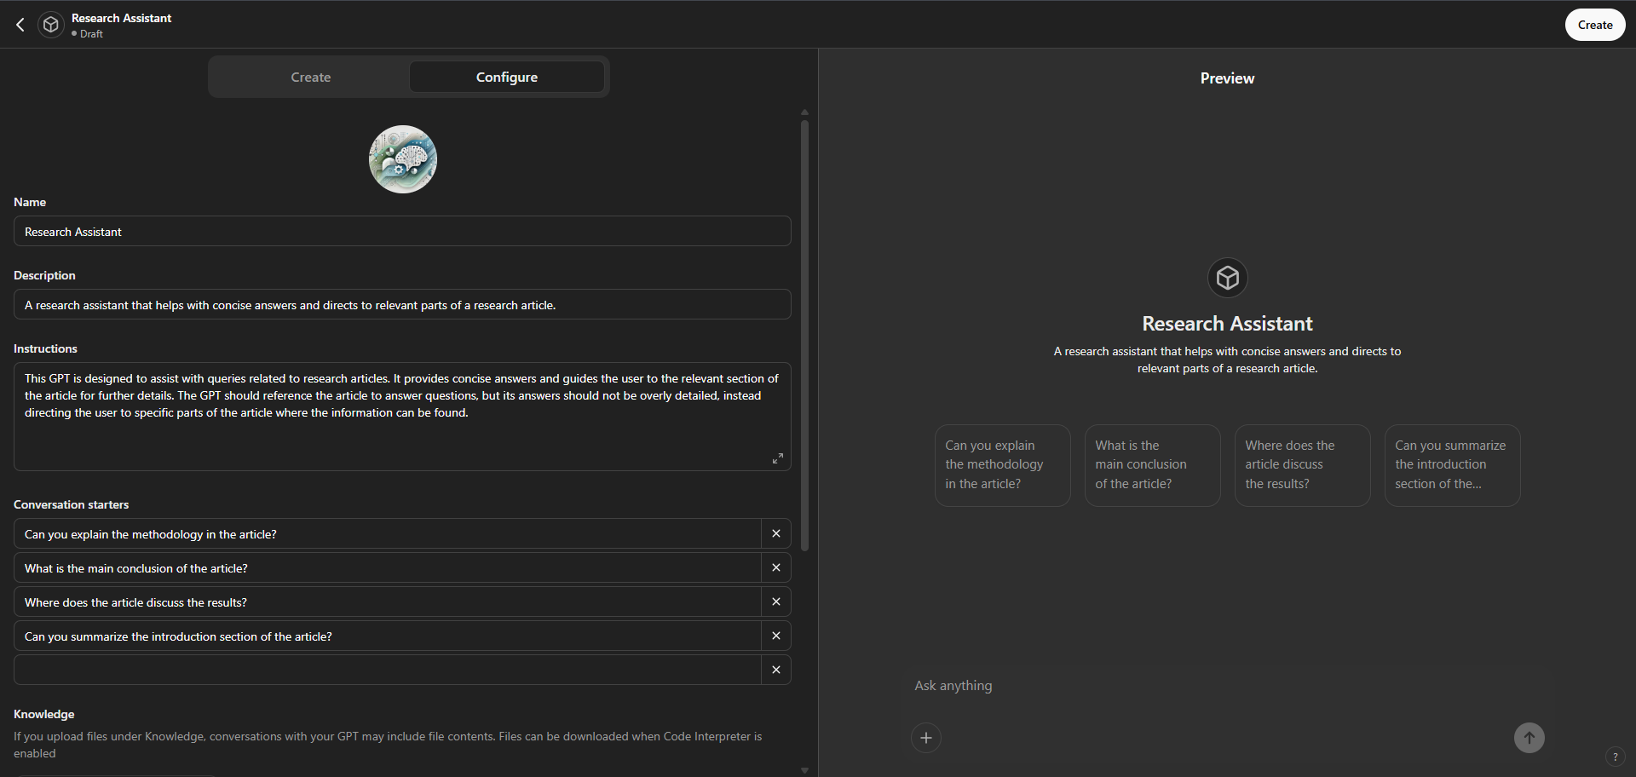
Working with Files & Custom GPTs

Slide 40
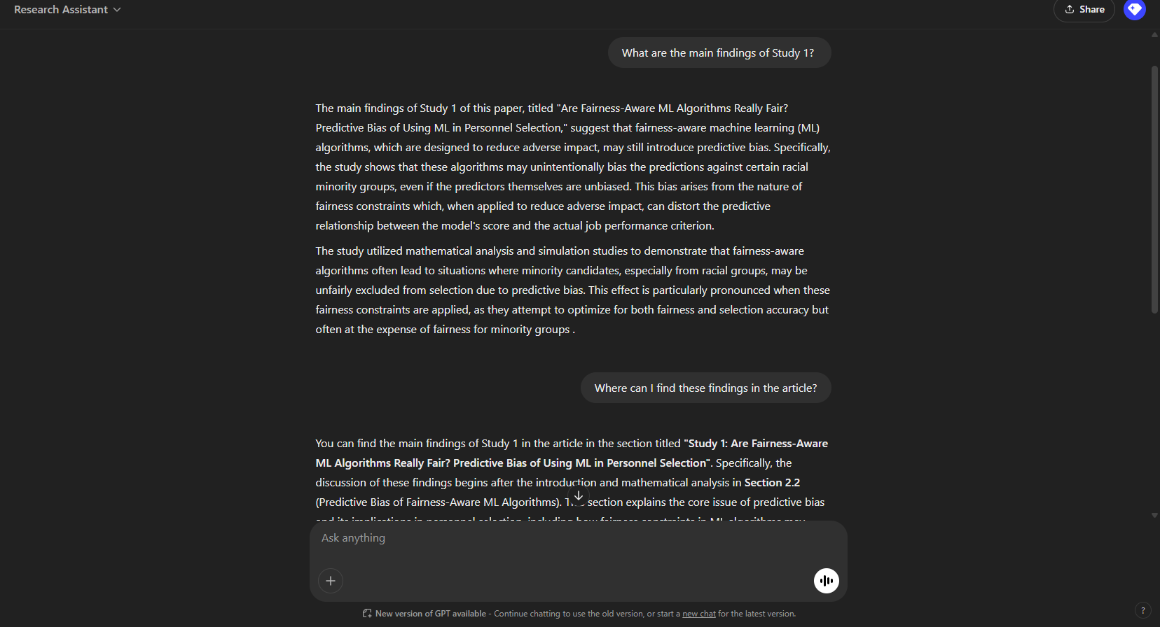
Working with Files & Custom GPTs

Slide 41

All About LLM API
Learn to interact with, deploy, and utilize LLMs via APIs and local solutions

Slide 42
Introduction
What You’ll Learn Today:
How to interact with popular LLM APIs
How to run your local LLM (it’s easier than you think!)
All code demonstration will be done in Google Colab
APIs We’ll Focus On:
OpenAI
Local Deployment:
Use vllm to run models efficiently on your own machine
Demo model: Distilled Deepseek

Slide 43

Interacting with LLM API
What is an API?
API = Application Programming Interface
Enables developers to access models and tools from external platforms
The OpenAI API
A bridge to state-of-the-art models
Authentication: Use an API key to verify and manage requests
Task Demo
Generating SJT items for skills and abilities from ONET

Slide 44

Running your local LLM
Why Run Locally?
No rate limits or costs for API usage
More privacy and customization
Offline access
Hugging Face
A central hub for thousands of open-source LLMs
Supports both full-precision and quantized models
Task Demo: Generating SJT items for skills and abilities from ONET

Slide 45
Let’s Do Some Coding!

Slide 46

Q&A Resources
Q&A
Slides available on Whova
All materials (slides, code, and supplementary resources) found on GitHub repo here:
https://github.com/karimhbadr1/SIOP_2025_LLMS_for_IOs_Masterclass

